Slide 1
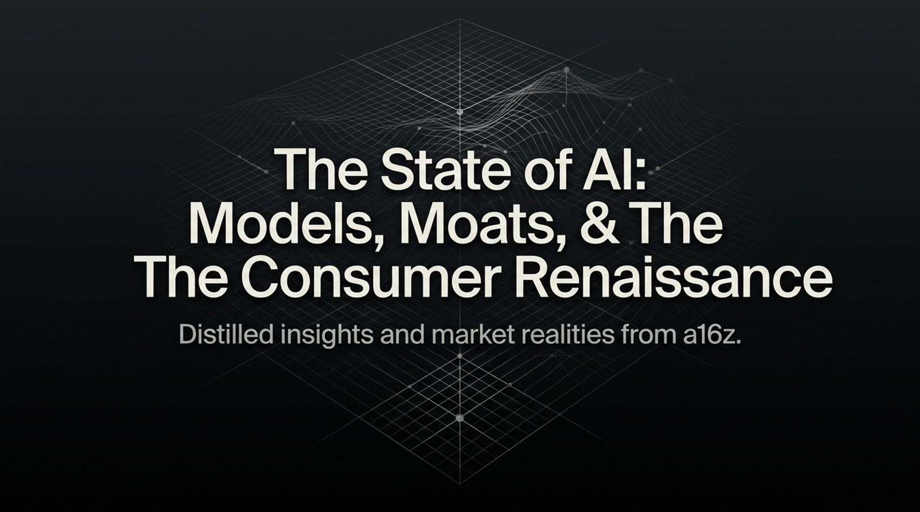
Notes:
Welcome, everyone. Today we’re diving into the state of artificial intelligence—moving past the superficial headlines to analyze what is actually happening across models, competitive moats, and consumer behavior.
Over the past few years, the prevailing market narrative hovered around two extremes: either AI is an inflated bubble that is bound to pop, or it’s a total winner-take-all monopoly dominated by one or two tech giants. What we at Andreessen Horowitz are seeing on the ground is far more nuanced, dynamic, and frankly, exciting.
We are entering what we call 'The Consumer Renaissance'. We are seeing a fundamental shift from simple prompt-response interactions to sovereign agents capable of autonomous execution, shifting UI paradigms, and a radical transformation in consumers' willingness to pay.
Over the next hour, we’ll unpack the macro economics of compute, look under the hood of enterprise strategy, examine why traditional moats are changing, and explore how startups are building sustainable value at the application layer. Let's jump in.
https://www.youtube.com/watch?v=zEZ0rQ8Ef-Y

Slide 2
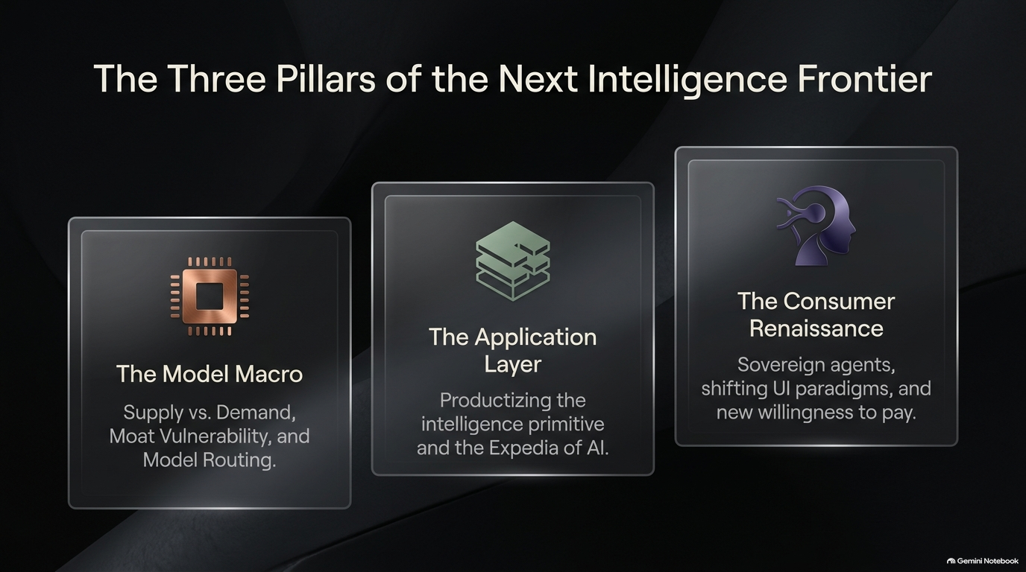
Notes:
To frame today’s discussion, we have structured our analysis into three distinct pillars that define the next intelligence frontier:
1. The Model Macro: We’ll look at the fundamental supply and demand dynamics powering the AI ecosystem. We’ll evaluate why compute prices—contrary to standard hardware deflation—are behaving strangely, how developer sentiment is shifting in a multi-winner world, and which enterprise moats remain safe versus those facing existential risk.
2. The Application Layer: Here, we focus on how raw intelligence primitives are productized. We’ll introduce the concept of 'The Harness' and explain why model routing—what we call the 'Expedia of AI'—is fast becoming the standard architecture for modern software applications.
3. The Consumer Renaissance: Finally, we’ll explore how sovereign agents, context-compounding loops, and elevated price ceilings ($200 to $2,000 per month) are unlocking unprecedented opportunities for consumer software.
Each pillar represents a critical piece of the puzzle for founders, investors, and enterprise leaders navigating this space.

Slide 3
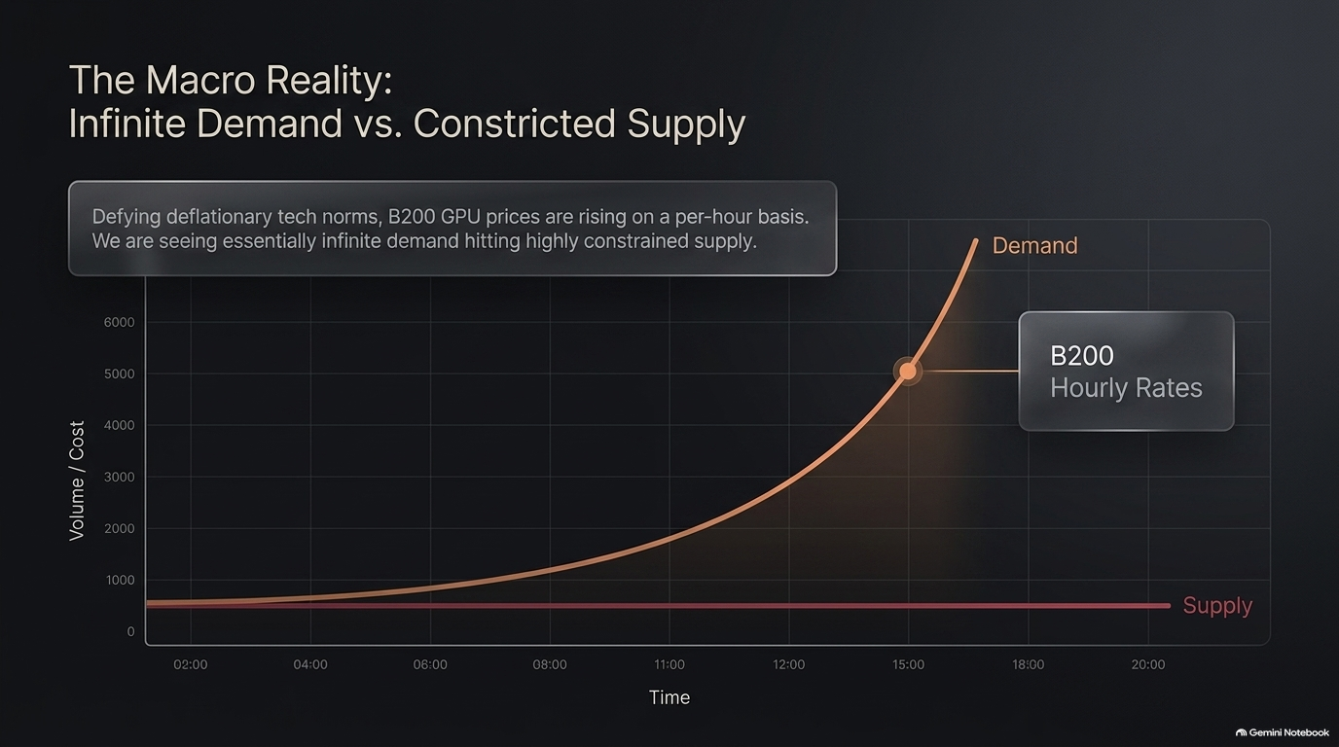
Notes:
Let's start with the macro picture. There is an ongoing public debate about whether AI spending represents an infrastructure bubble. But when you examine second-order market indicators, a very different story emerges.
Historically, technology follows a relentless deflationary curve—compute, bandwidth, and storage become exponentially cheaper over time. However, right now we are witnessing a complete defiance of traditional tech norms. Hourly rental rates for GPUs—such as Nvidia's B200 architectures—are actually increasing on a per-hour basis.
Why is this happening? Because we are hitting a structural wall where essentially infinite demand is crashing into severely constricted physical supply. Every major laboratory, enterprise, and startup is attempting to scale inference and training simultaneously.
When critics point to tech CAPEX or stock volatility and scream 'bubble!', they miss this underlying fundamental: the market is not suffering from a lack of end-user demand; it is bottlenecked by hardware availability, power constraints, and datacenter footprint. As long as demand outstrips supply to this degree, compute remains a prized economic asset.

Slide 4
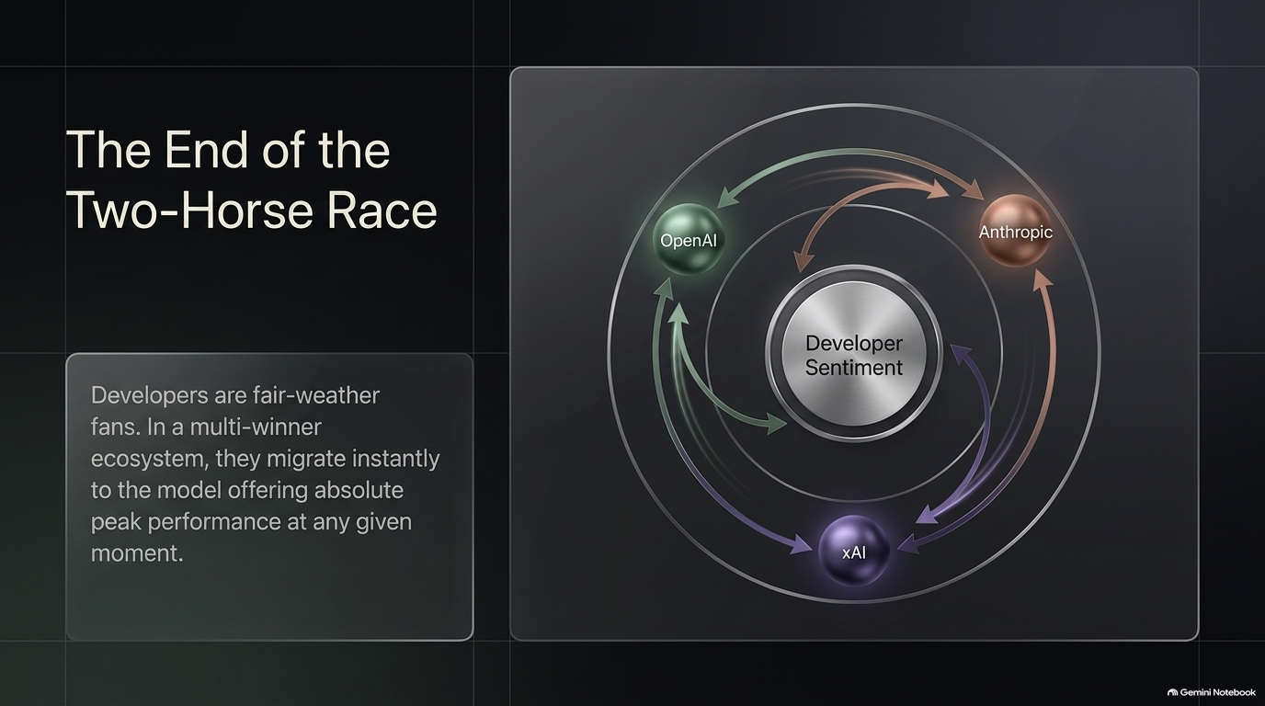
Notes:
For a long time, the model market was perceived as a tight two-horse race between OpenAI and Anthropic. If you fast-forward to today, that dynamic has shattered. We have officially entered a multi-winner ecosystem, recently exemplified by xAI rapidly rising to frontier performance.
What is critical to understand about developers in this space is that developers are fair-weather fans. There is virtually zero brand loyalty when it comes to API integration. Developers will instantly migrate their traffic to whichever model offers absolute peak performance, lowest latency, or superior reasoning capabilities at any given moment.
We saw Anthropic hold massive developer mindshare, then OpenAI surged back with major breakthroughs in reasoning and coding harnesses, while xAI and open-weight models accelerated on their flanks. Because benchmark lead times are measured in weeks rather than years, model providers cannot rely on customer lock-in. They must continuously innovate to retain developer mindshare.

Slide 5
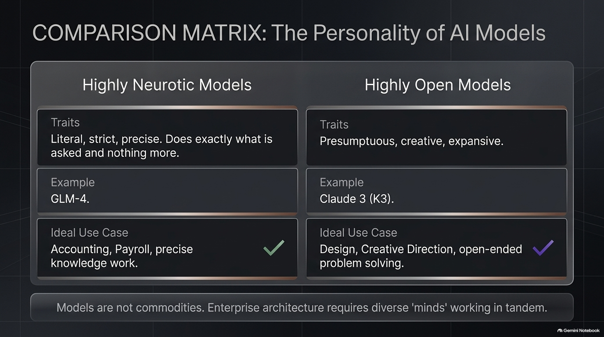
Notes:
One of the most significant mindset shifts in AI engineering is realizing that models are not interchangeable commodities. Different foundation models exhibit distinct 'personality traits' and behavioral profiles.
On one end of the spectrum, you have Highly Neurotic / Precise Models—such as GLM-4. These models are literal, strict, and risk-averse. They do exactly what they are instructed to do and nothing more. This makes them ideal for tasks requiring exactness, like accounting, payroll processing, compliance, and strict knowledge retrieval.
On the other end, you have Highly Open / Creative Models—like Claude 3 or K3 variants. These models are presumptuous, highly creative, and expansive. They excel at open-ended problem solving, product design, copywriting, and ideation.
Just as human organizations require a mix of detail-oriented accountants and visionary designers, enterprise AI architectures require diverse 'minds' working in tandem. Selecting a single model for an entire enterprise stack is fundamentally flawed.

Slide 6
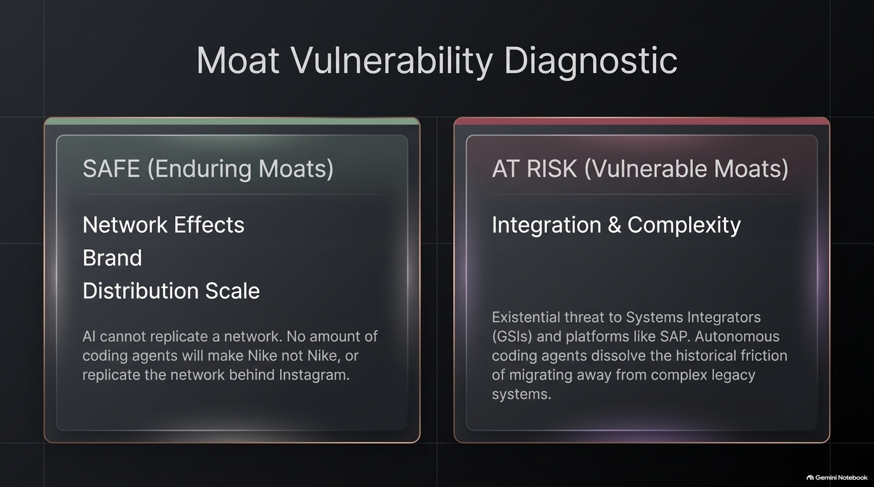
Notes:
A frequent question from founders and enterprise executives is: 'Does AI kill competitive moats?' The answer depends on the type of moat you have.
Safe Moats (Enduring Value):
Network EffectsValue): The moat most threatened by AI is Integration & Complexity. Legacy platforms like SAP: AI cannot magically synthesize a two-sided marketplace. The value of Instagram is its social graph, not its codebase.
Brand: No autonomous coding agent will make Nike stop being Nike. Brand affinity and trust remain completely intact.
Distribution Scale: Existing distribution pipes remain deeply defensible.
At-Risk Moats (Vulnerable or old-guard ERPs built massive defensibility simply because migrating off them was too painful and expensive. Global Systems Integrators (GSIs) built multi-billion-dollar businesses around managing this friction.
Autonomous coding agents dissolve this historical friction. When agents can automatically map, refactor, and migrate legacy codebases in hours rather than years, 'complexity' ceases to be a moat and becomes an invitation for disruption.

Slide 7
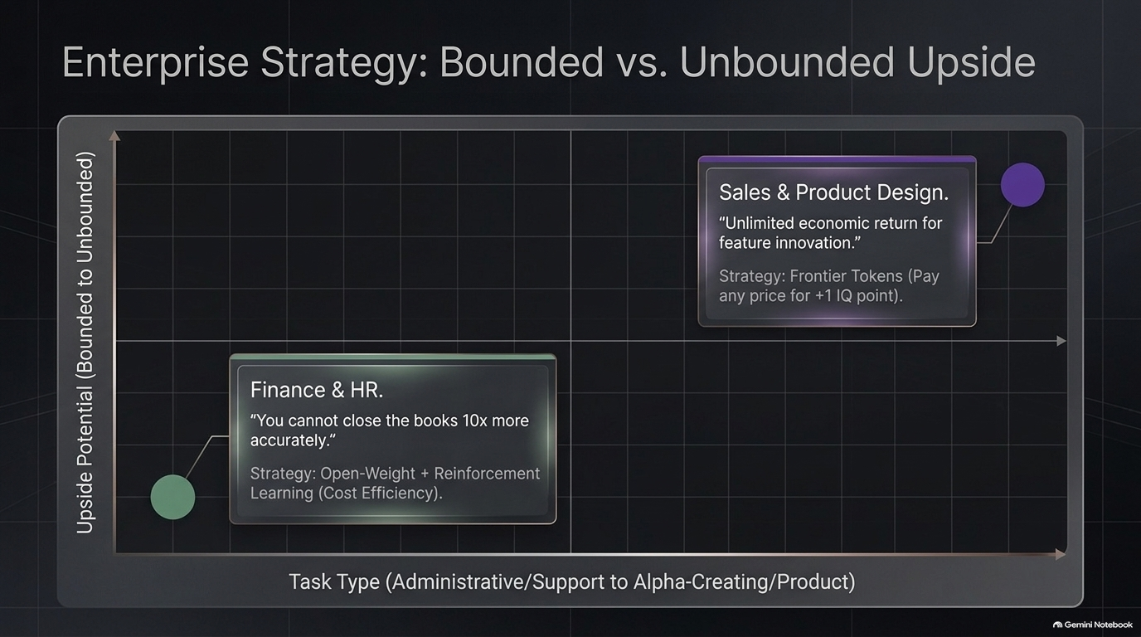
Notes:
How should an enterprise deploy its AI token budget? You must categorize enterprise workflows based on their economic upside profile:
Bounded Upside Tasks (e.g., Finance, HR, Compliance): In finance or payroll, success has an upper limit—closing the books accurately. You cannot close the books '10x more accurately'. Because the upside is capped, spending top-dollar on expensive frontier models is economically irrational. Here, the optimal strategy is using Open-Weight Models fine-tuned with Reinforcement Learning to maximize cost efficiency.
Unbounded Upside Tasks (e.g., Sales, Product Design, R&D): Conversely, in sales or core product innovation, the economic upside is theoretically infinite. A smarter model that closes a multi-million-dollar deal or invents a hit feature delivers vast economic return.
For unbounded tasks, you should use Frontier Tokens and pay virtually any price for even a single additional point of intelligence or reasoning capability.

Slide 8
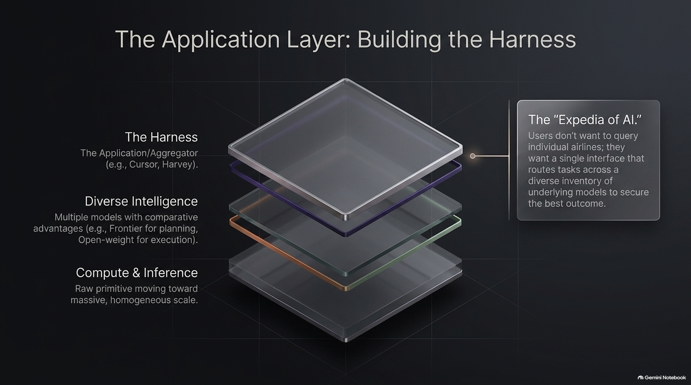
Notes:
Now let's examine the Application Layer. Early on, people worried that model providers would swallow all application software. Instead, we are seeing specialized software applications thrive by acting as 'The Harness'.
Raw compute and foundation models are moving toward massive, homogeneous scale at the bottom of the stack. The application layer—examples like Cursor in coding or Harvey in legal—serves as the harness that productizes this intelligence primitive.
We call this concept 'The Expedia of AI'. When you book a flight, you don't go directly to separate airline portals to query individual routes; you use Expedia to search across available inventory and find the optimal path.
Modern applications do the exact same thing for intelligence: they route tasks dynamic across a diverse set of underlying models—using a frontier model for high-level reasoning and planning, and a lightweight open-weight model for rapid execution. The user gets a seamless outcome without worrying about model selection underneath.

Slide 9
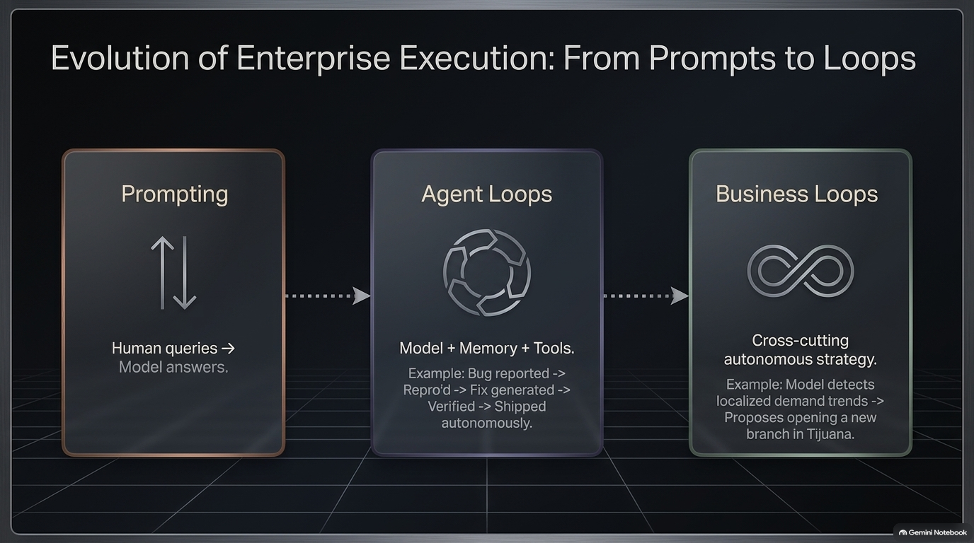
Notes:
Enterprise execution is undergoing a generational shift. We are moving through three distinct evolutionary stages:
Stage 1: Prompting (2022–2023): A human types a query, and a model generates an answer. This is basic Q&A.
Stage 2: Agent Loops (2024–2025): We combine a Model with Memory and Tools inside a feedback loop. Take automated software engineering as an example: a user reports a bug -> the agent reproduces it -> generates a fix -> verifies tests -> and autonomously ships code.
Stage 3: Business Loops (The Frontier): This is cross-cutting, autonomous strategy. An agent analyzes enterprise data, notices localized demand trends, and proactively recommends opening a new retail location or modifying supply chain routing.
The ultimate goal for enterprise software is not to provide faster text generation, but to embed intelligence into continuous, self-healing, self-optimizing operational loops.

Slide 10
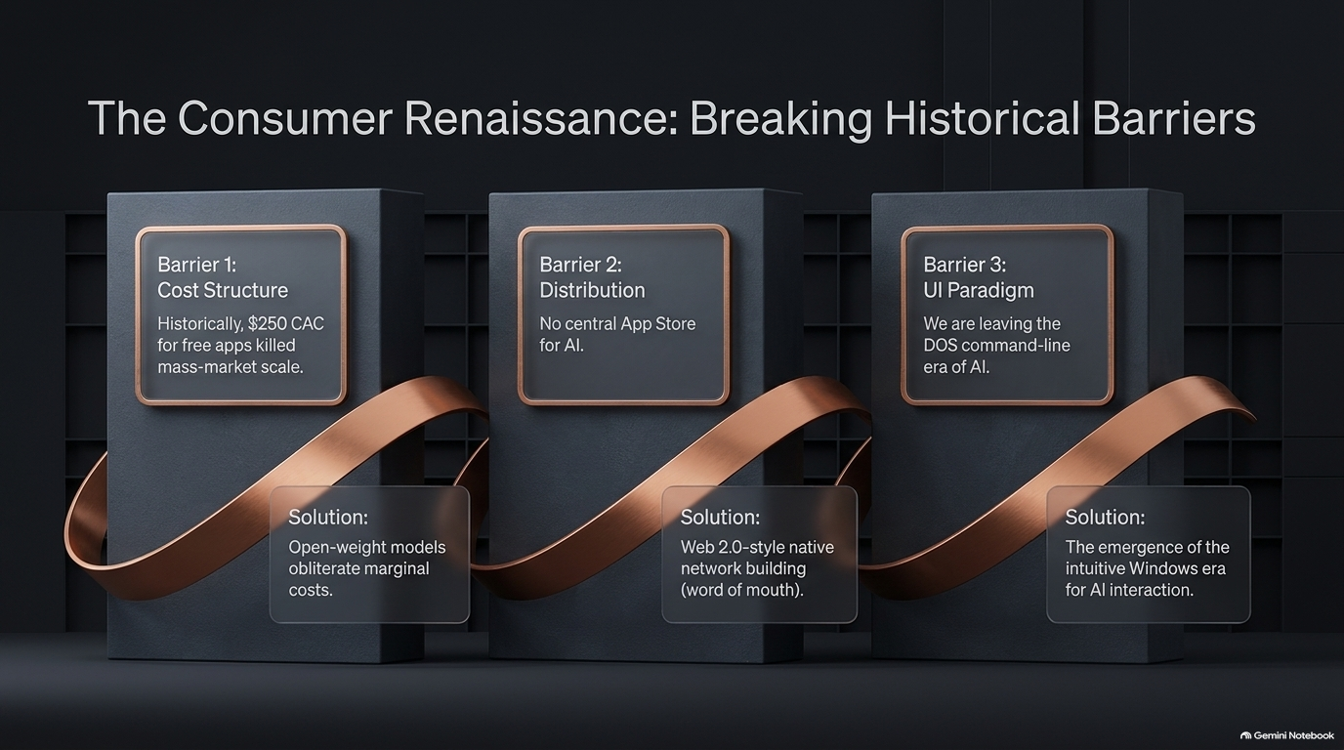
Notes:
For years, consumer software felt stagnant. High Customer Acquisition Costs (CAC) and zero marginal revenue made consumer apps difficult to scale profitably. Today, consumer AI is breaking through three historical barriers:
Barrier 1: Cost Structure. Historically, high compute and API costs created prohibitive onboarding expenses (sometimes $250+ per user). Solution: High-performing open-weight models have dramatically lowered marginal inference costs.
Barrier 2: Distribution. There is no central 'AI App Store'. Solution: Modern consumer AI products rely on organic, Web 2.0-style word-of-mouth growth and direct consumer network effects.
Barrier 3: UI Paradigm. We have been stuck in the 'DOS command-line era' of simple chat boxes. Solution: We are entering the 'Windows era' of AI—intuitive, rich, ambient interfaces where agents work natively alongside users.

Slide 11
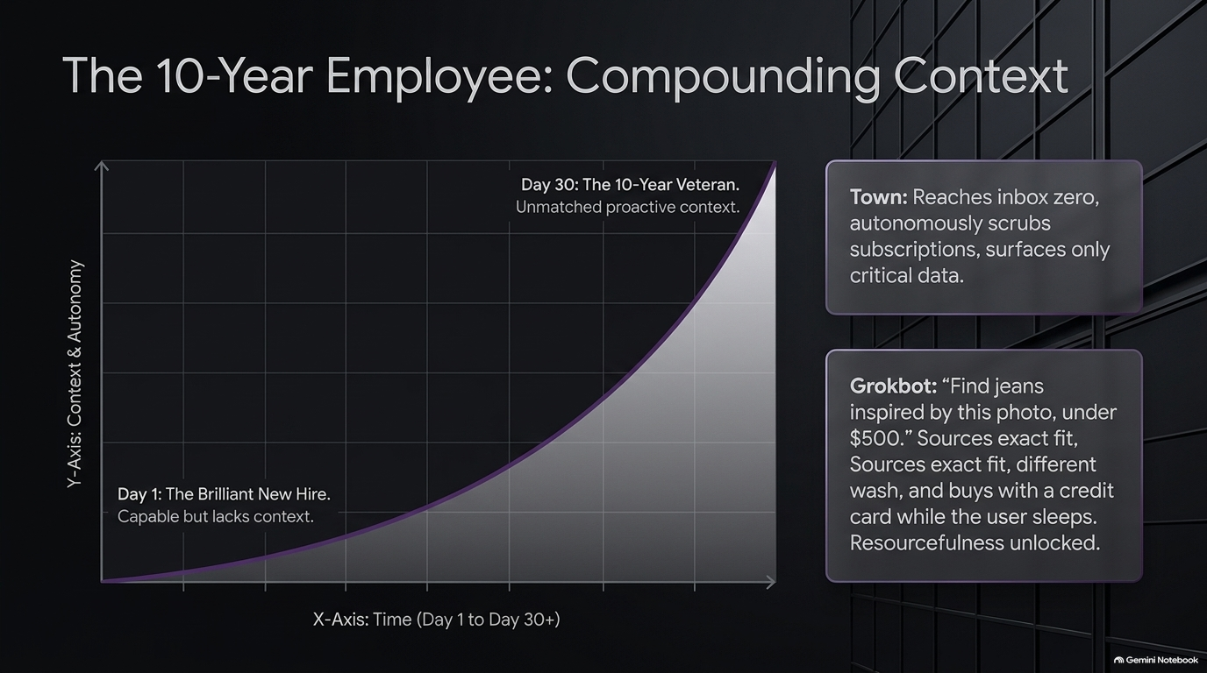
Notes:
Why do consumer and prosumer AI products show improving retention curves? It comes down to compounding context.
On Day 1, an AI agent is like a brilliant new hire—extremely capable, but lacking your personal context, preferences, and historical data.
By Day 30, through persistent long-term memory and autonomous execution, that agent operates like a 10-year veteran. It anticipates needs, manages preferences, and acts proactively.
Look at real-world applications:
Town: An agent that cleans your inbox to zero, audits subscriptions, and surfaces critical updates automatically.
Grokbot: A user takes a photo of jeans and gives a budget. The bot searches styles, identifies the exact fit, compares prices, and executes the purchase while the user sleeps.
The more context an agent accumulates, the higher the switching cost becomes, creating deep product defensibility.

Slide 12
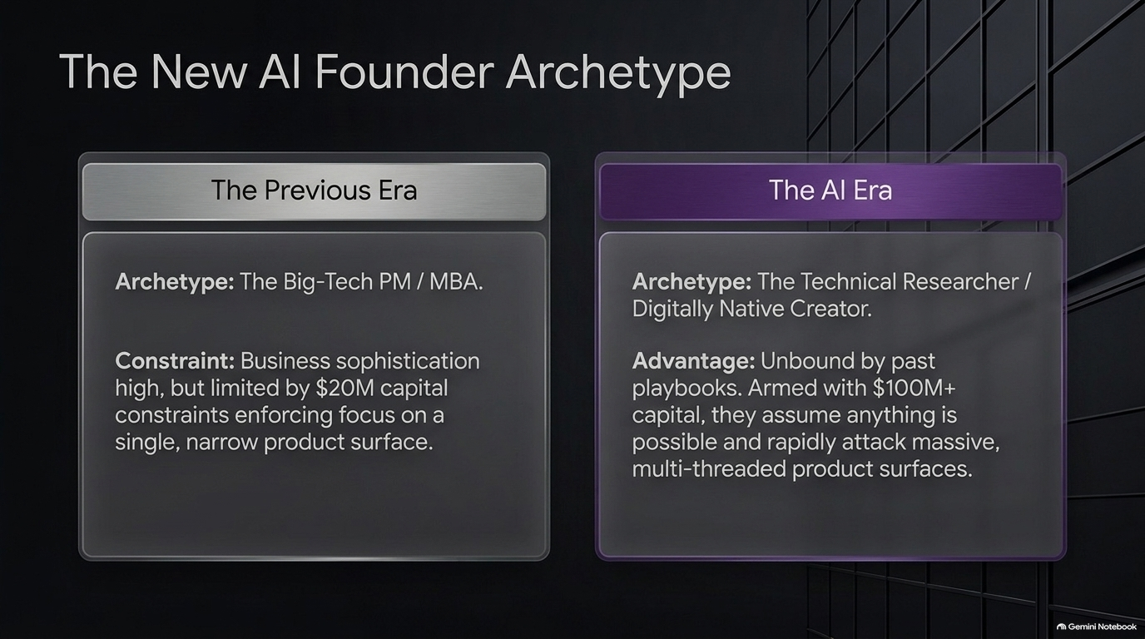
Notes:
As market conditions change, the ideal founder profile evolves.
In the Previous Era, the archetypal founder was a Big-Tech Product Manager or MBA. They possessed strong business sophistication, but capital and engineering constraints forced them to focus narrowly on single, incremental product surfaces.
In the AI Era, the dominant archetype is the Technical Researcher or Digitally Native Creator.
These founders are unbound by legacy playbooks. They assume anything is technically possible, and when paired with significant capital, they rapidly attack massive, multi-threaded product surfaces simultaneously.
Technical fluency is now the primary lever for product velocity. Business models and go-to-market mechanics can be taught, but deep technical intuition is essential for building at the frontier.

Slide 13
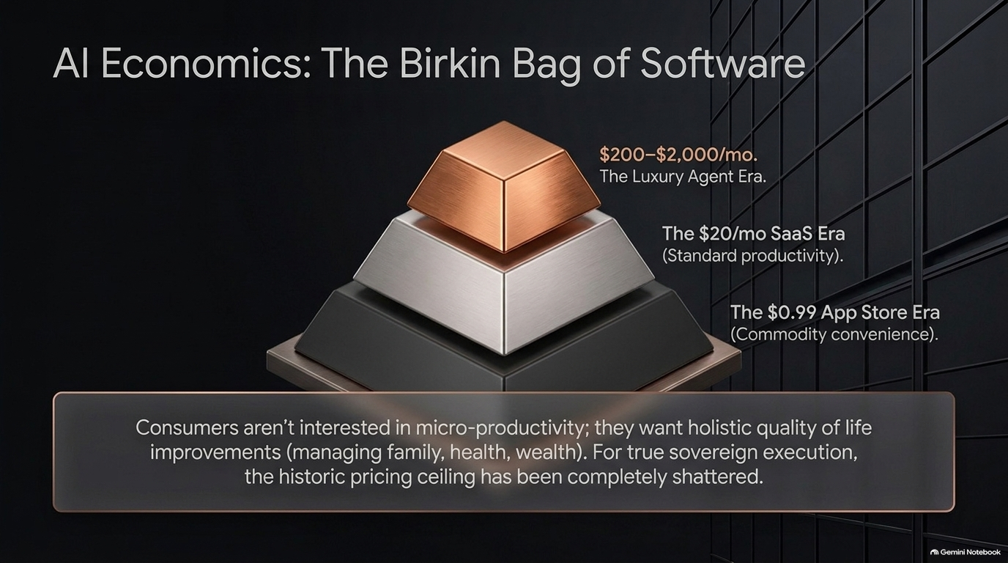
Notes:
One of the most surprising developments in consumer AI is price elasticity.
For a decade, consumer software was anchored to the $0.99 App Store mentality or $20/month SaaS subscriptions. Consumers resisted paying for incremental digital tools.
AI agents have broken this price ceiling, creating 'The Luxury Agent Era' ($200 to $2,000 per month). We call this 'The Birkin Bag of Software'.
Consumers are not looking for minor productivity tweaks. They are willing to pay premium prices for tools that deliver real quality-of-life outcomes—managing household logistics, optimizing personal finances, handling administrative burdens, or coordinating health care.
When software transitions from assisting work to executing labor, pricing shifts from software budgets to labor budgets.

Slide 14
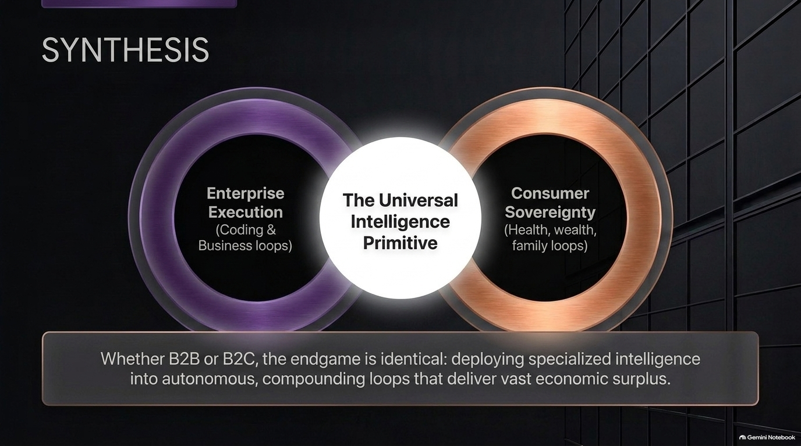
Notes:
To pull these threads together: whether you look at B2B enterprise software or consumer applications, the endgame is identical.
Both sides leverage The Universal Intelligence Primitive.
On the Enterprise side, intelligence is deployed into coding and operational loops to drive corporate efficiency.
On the Consumer side, intelligence is deployed into personal health, wealth, and family management loops to unlock personal sovereignty.
The underlying tech stack, model routing architectures, and memory structures are remarkably aligned. Winning products deliver autonomous, compounding loops that unlock substantial economic surplus for end users.

Slide 15
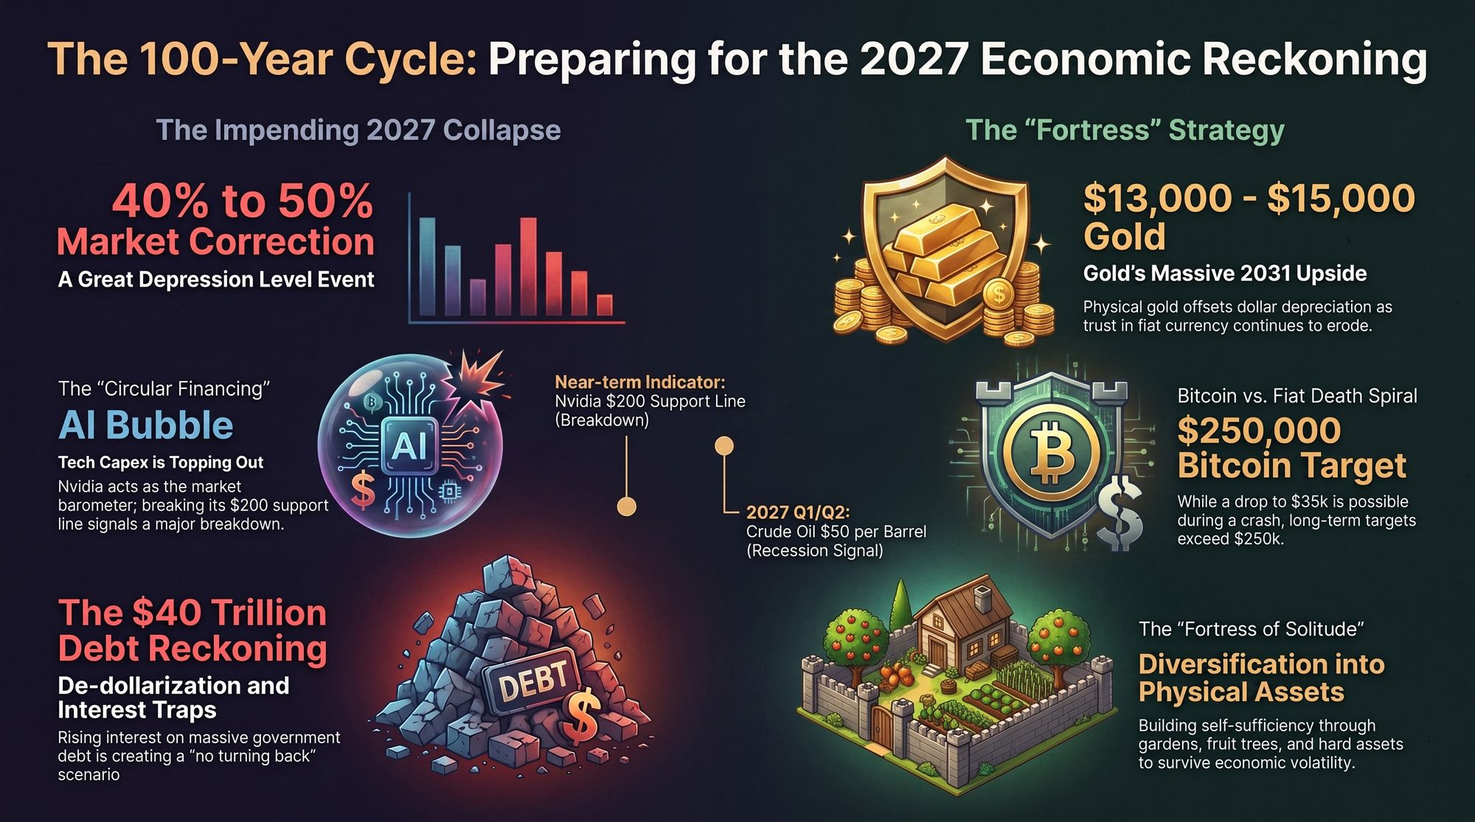
Notes:
To close out this first section of our briefing, we must look at the broader macroeconomic backdrop. While technological progress in AI remains rapid, market cycles do not operate in a vacuum.
Investors and founders should monitor key macro risk indicators:
Circular Financing & Infrastructure Risk: As capital flows heavily into datacenters and hardware, tracking real-world demand versus speculative capacity expansion remains vital.
Sovereign Debt & Monetary Dynamics: Broader economic volatility, interest rate fluctuations, and debt levels continue to influence capital markets and tech valuations.
Asset Allocation & Resilience: A balanced strategy focuses on building operational resilience. In AI, that means focusing on genuine enterprise value creation, sustainable revenue generation, and defensive tech stacks that withstand market shifts.
Building durable companies requires capitalizing on technical momentum while maintaining disciplined unit economics.
Thank you for your time, and let's open the floor to questions.

